Slide 1
Project Hawkeye 1 & 2
Project Kick-off Meeting (HE1 & HE2)
1st Sept 2025

Slide 2
Agenda
Project Team Structure
HE1 Milestones and Deliverables
HE2 Milestones and Deliverables
Project Management Plan
Urgent / Critical Tasks

Slide 3
Project Team Structure
David Siow
[Project Director]
Liow Sin Hwa
[Consultant]
CJ Lim
[Project Manager]
Eric See [Technical Lead]
Tan Jun Rong [Lead Developer]
Rafiq
[Lead UI Designer]
Liao Peiru [Business Analyst]
Dr Liu Jin [Lead Data Scientist]
Judy [Data Scientist]

Slide 4
HE1 Project Milestones and Deliverables [1/3]
S/N | Milestones | Deliverables | Target Date
1 | Critical Design Review (CDR) | Project Management Plan (PMP) Preliminary System & Software Design UX/UI Design Process Work flow | August 2025
2 | Software Verification & Iteration #1 | Software Requirement Specification (Preliminary version) System Design Document (Preliminary version) | October 2025
3 | Software Verification & Iteration #2 | Software Requirement Specification (SRS) System Design Document | Jan 2026

Slide 5
HE1 Project Milestones and Deliverables [2/3]
4 | Delivery of DBMS and Acceptance | Delivery of DBMS Deliver the Test Plan, Test Results and successfully conducted the following Acceptance Tests: Installation Test; System Functional Test; System Interface/Integration Test; System Performance Test; System Load Test Stress Test Source Code Security Test using SAST Tool User Acceptance Test Conduct Pre-UAT Training; Hardware/Software Configuration Document System Administration/Operations Document User Guide | October 2026

Slide 6
HE1 Project Milestones and Deliverables [3/3]
5 | Commissioning Date & Completion of Training | Conduct in-house training with users: User Training using DBMS; User Training for Trainers; System Installation & Configuration Training; Training Proposal & Plan Training materials | November 2026
6 | Acceptance & Sign-off | Hardware Maintenance Plan Software & Application Maintenance Plan Source Code | March 2027
7 | End Warranty |  | Feb 2028

Slide 7
HE2 Project Milestones and Deliverables [1/3]
S/N | Milestones | Deliverables | Target Date
1 | Preliminary Design Review (PDR) | Project Management Plan (PMP) | August 2025
2 | Critical Design Review (CDR) | Preliminary System & Software Design UX/UI Design Process Work flow | January 2026
3 | Software Verification & Iteration #1 | Software Requirement Specification (Preliminary version) System Design Document (Preliminary version) | April 2026
4 | Software Verification & Iteration #2 | Software Requirement Specification (SRS) System Design Document | July 2026

Slide 8
HE2 Project Milestones and Deliverables [2/3]
5 | Delivery & Acceptance of Link Analysis Software to STE for Integration | Delivery of Link Analysis Deliver the Test Plan, Test Results and successfully conducted the following Acceptance Tests: Installation Test; System Functional Test; System Interface/Integration Test; System Performance Test; System Load Test Stress Test Source Code Security Test using SAST Tool User Acceptance Test Hardware/Software Configuration Document System Administration/Operations Document | April 2027

Slide 9
HE2 Project Milestones and Deliverables [3/3]
6 | Delivery & Acceptance of Link Analysis Software | Conduct Pre-UAT training; User Guide | August 2027
7 | Commissioning Date & Completion of Training | Conduct in-house training with users: User Training using Link Analysis; User Training for Trainers; System Installation & Configuration Training; Training Proposal & Plan Training materials | September 2027
8 | Acceptance & Sign-off | Hardware Maintenance Plan Software & Application Maintenance Plan Source Code | January 2028
9 | End Warranty |  | January 2029

Slide 10
What’s in Project Management Plan?
Quality Management Plan
Coding Standard Guidelines
Risk Management Plan
Change Management Plan
Problem Management Plan
Configuration Management Plan
Communication Management Plan
Project Closure/Exit Management Plan

Slide 11
Urgent/Critical Tasks
17th September 2025 – Data mapping workshop with End User
Peiru, Dr. Liu – Lead the workshop session
October 2025 – Software V&I 1 [15%]
Complete at least 75 – 80% of the UI design
Refer to the documents, minutes and slides for workflow and designs
Rafiq – Lead the UI design
Eric and Jun Rong – Assist to prototype the UI and workflow
Agile Development Plan (by 15 September)
Use the User Story to plan the sprint and align with the project milestones;
Come out the Data Design***
Eric – Lead the development team
Notes:
Check with Peiru ..if she is comfortable to lead the workshop session

Slide 12
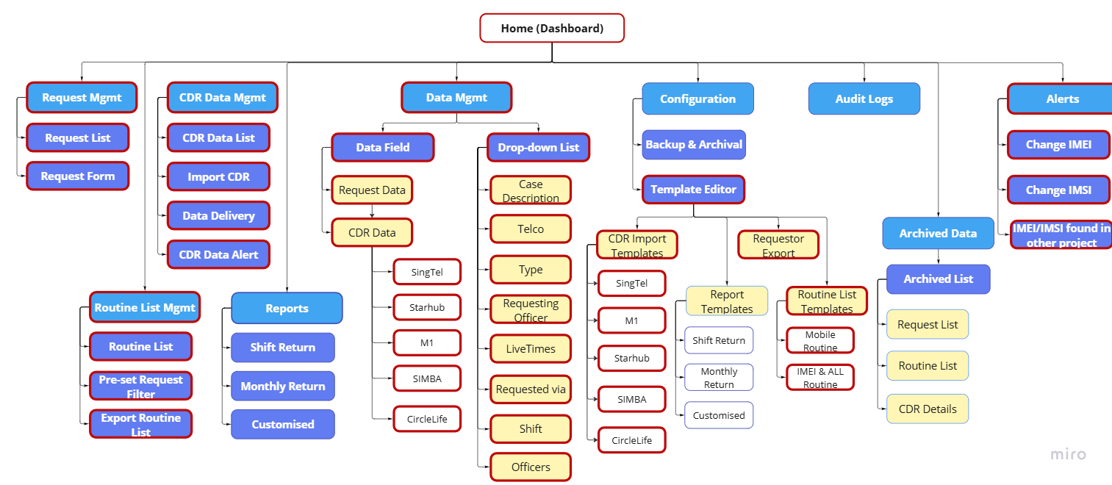
UI design to be completed by 1st V&I (red box)

Slide 13

Building a Cohesive Team
Notes:
Talk a bit on the customer reaction with us and a good start for the team till now…
Not a very big team … but we can do it with commitments…
I understand most of us are not full-time working… but I believe that we are a professional individuals should

Slide 14
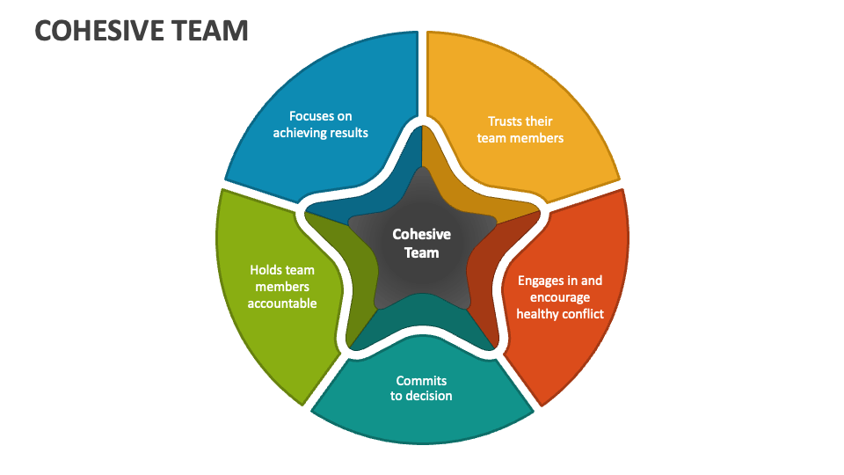
Notes:
Trust is a foundation for a cohesive team.
Constructive conflict… in debates.. Different in perspectives, explore solutions , strengthens bonds
Commitment… - on common goals
Accountability – high performing team stay accountable to one another… address unmet commitments…
Achieving Results … satisfaction…

Slide 15
Thank you!

